Slide 1
Problem Statement

Slide 2
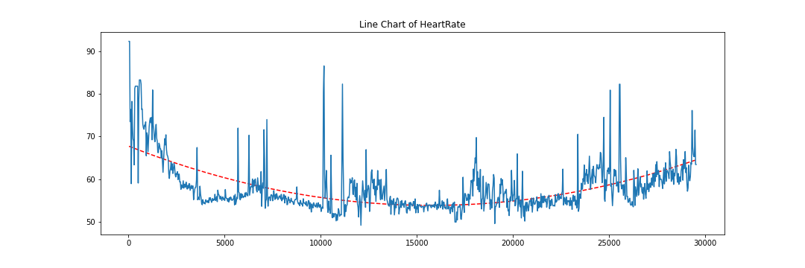
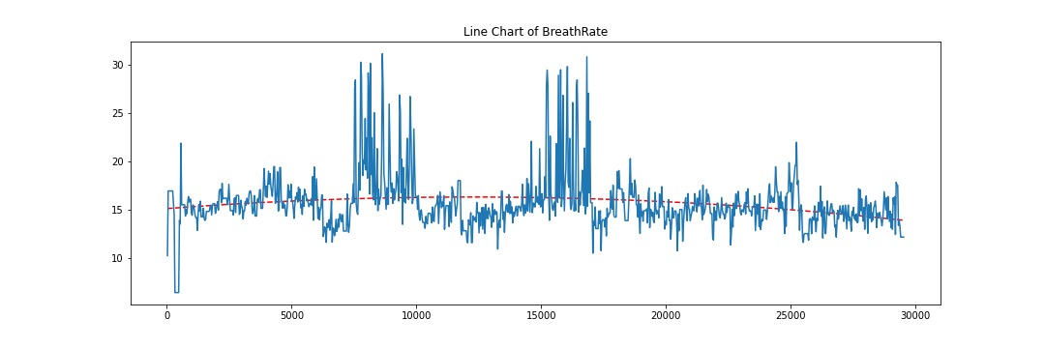
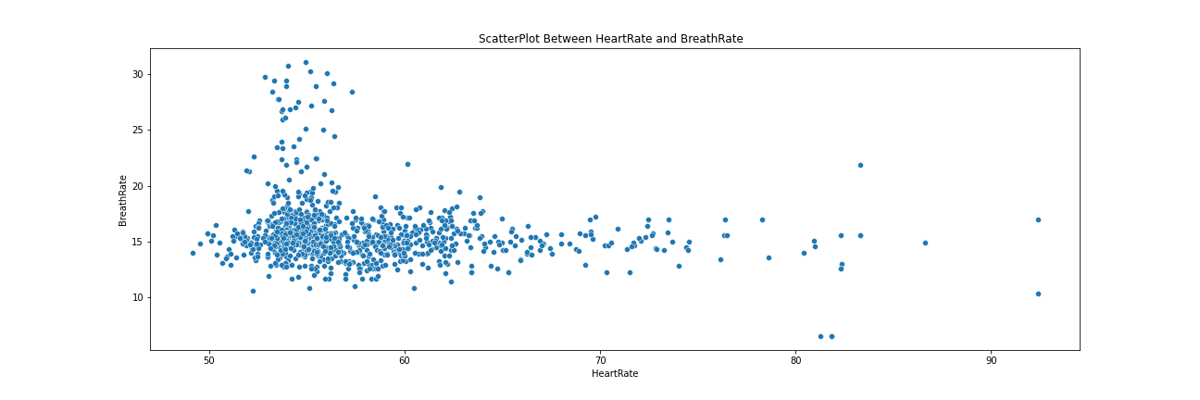
1st CSV

Slide 3
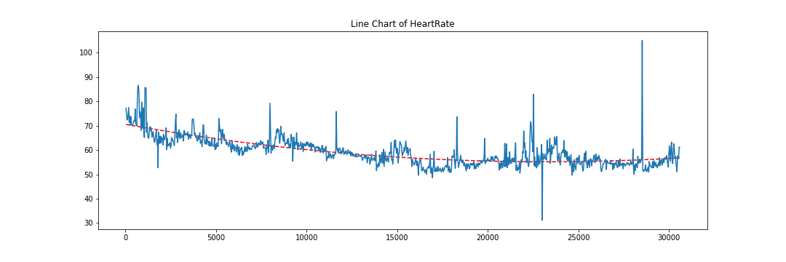
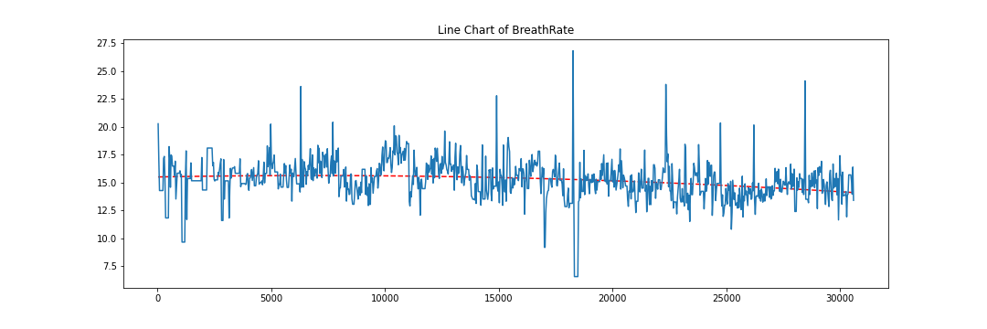
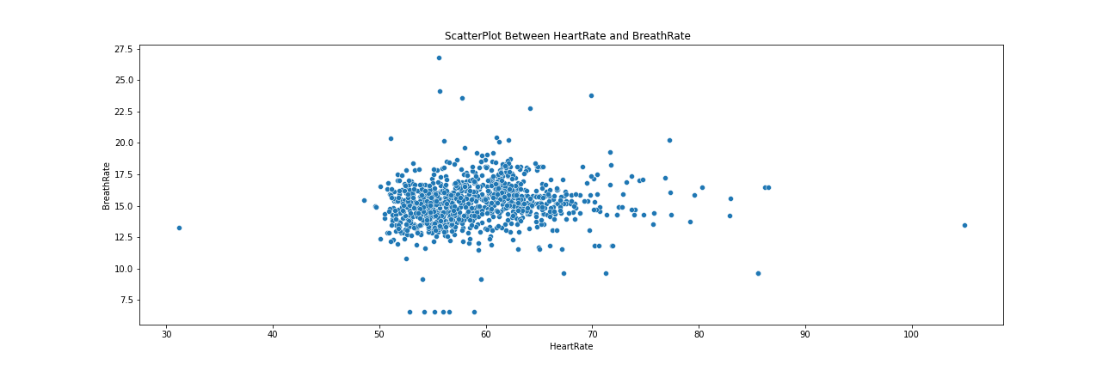
2nd CSV

Slide 4
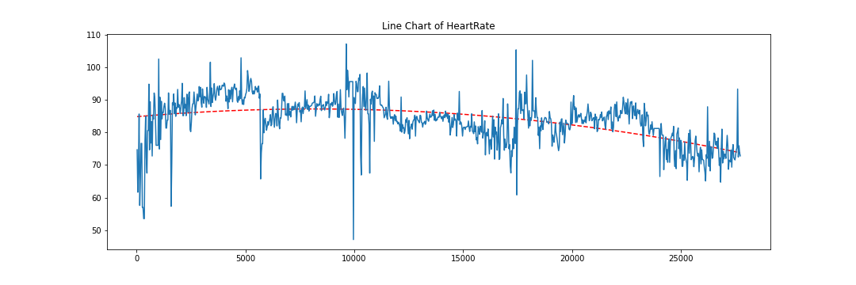
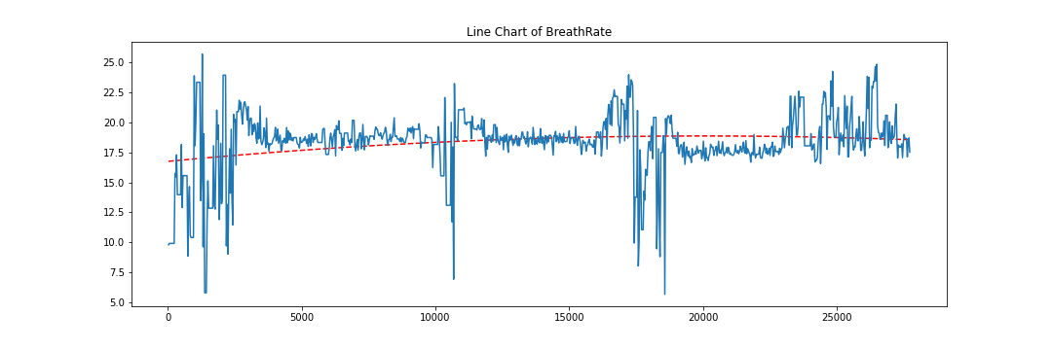
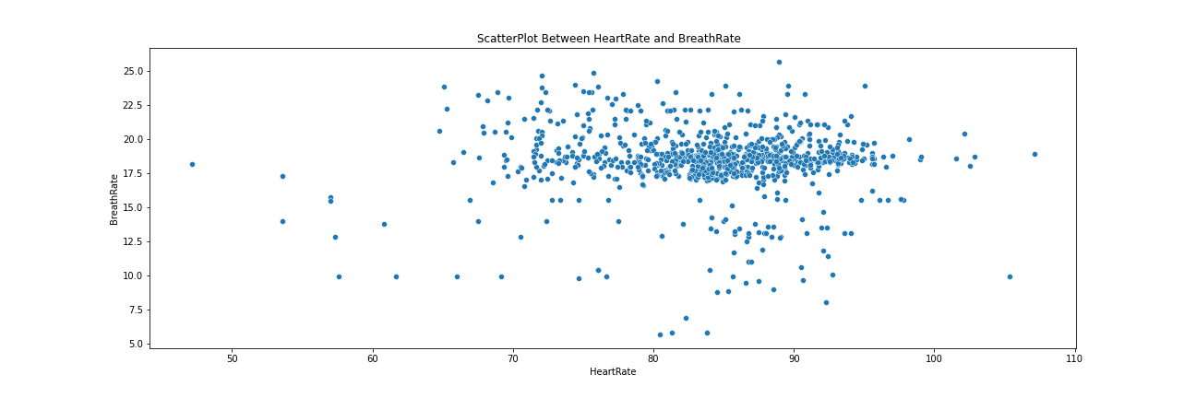
3rd CSV

Slide 5
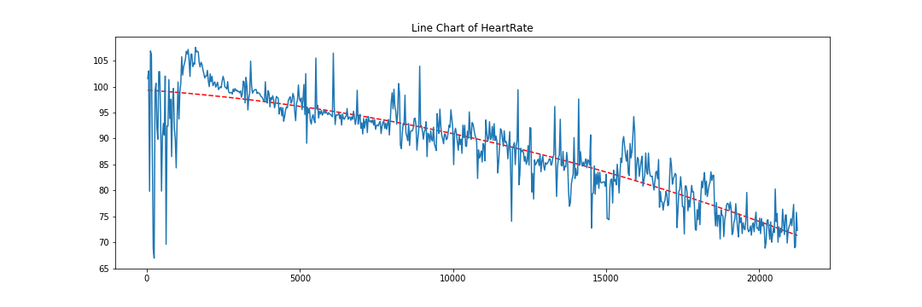
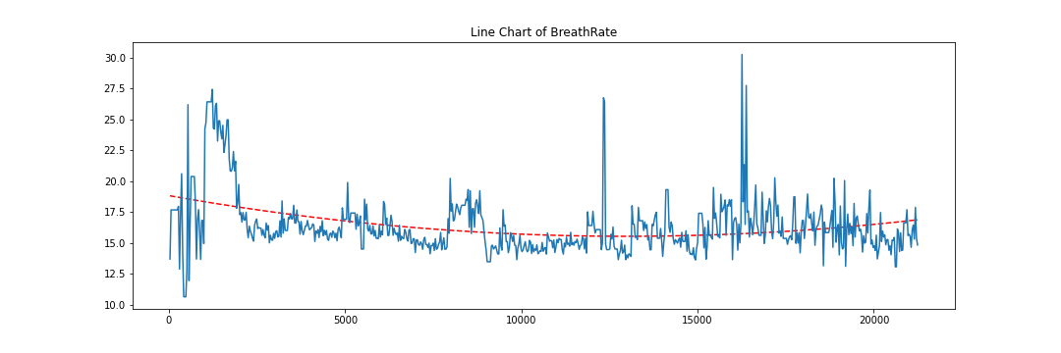
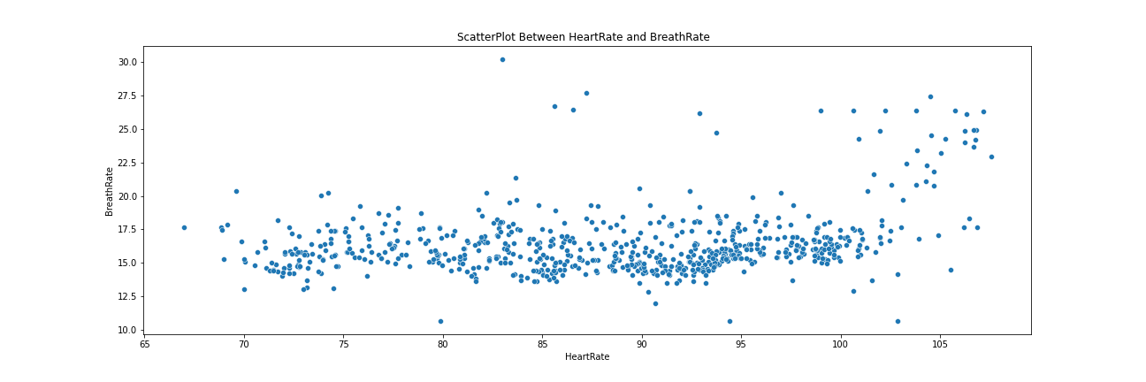
4th CSV

Slide 6
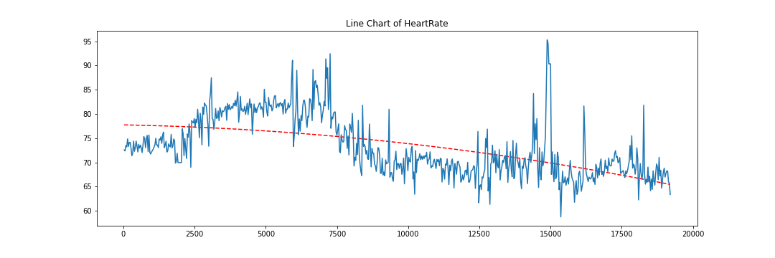
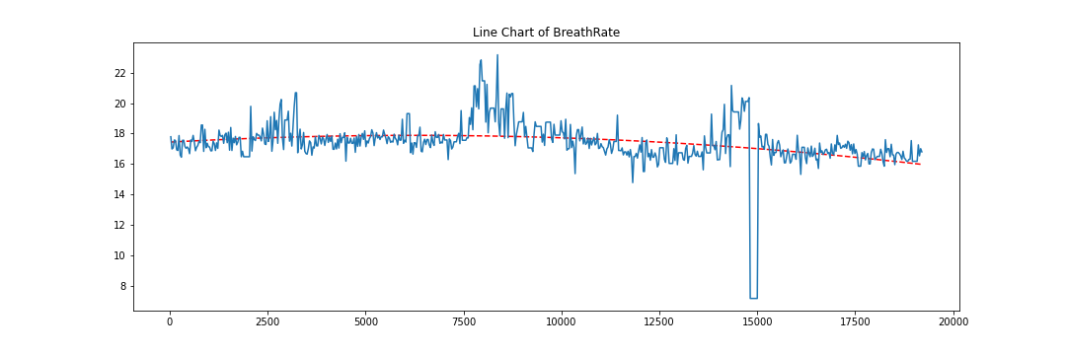
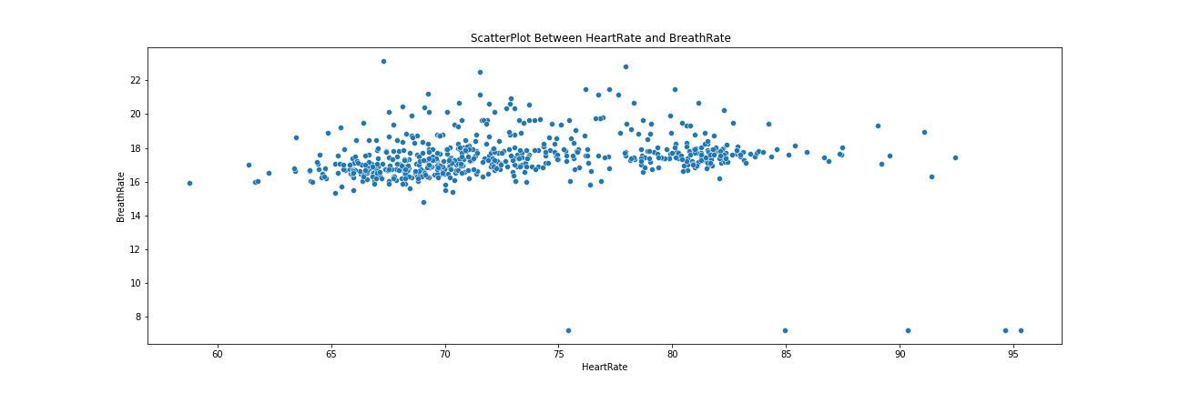
5th CSV

Slide 7
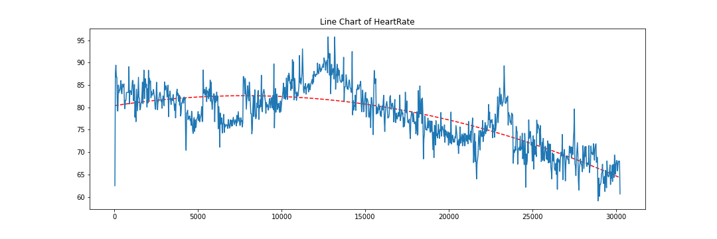
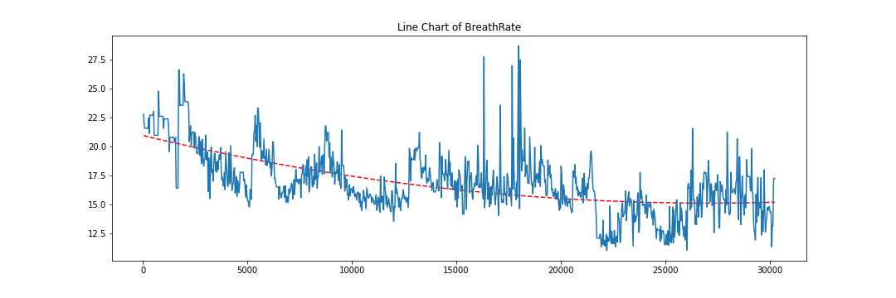
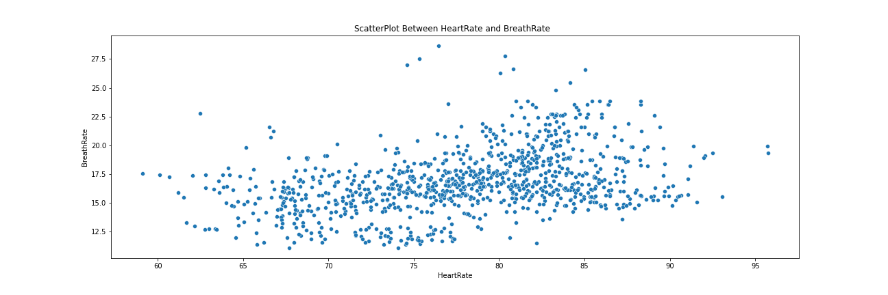
6th CSV

Slide 8
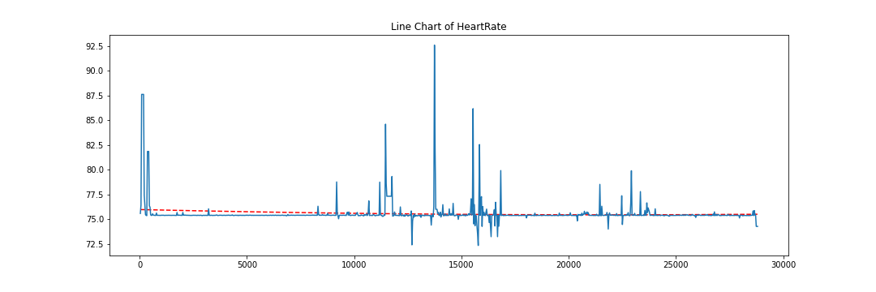
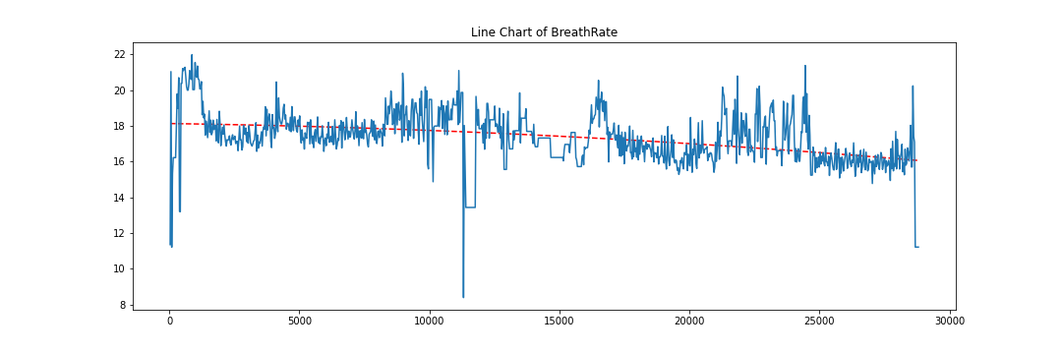
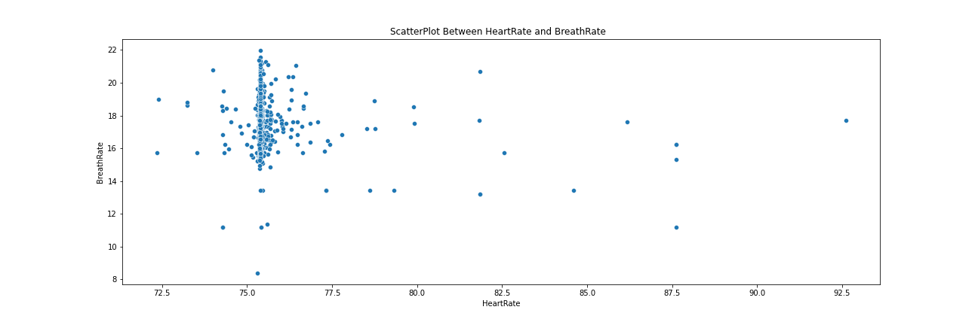
7th CSV

Slide 9
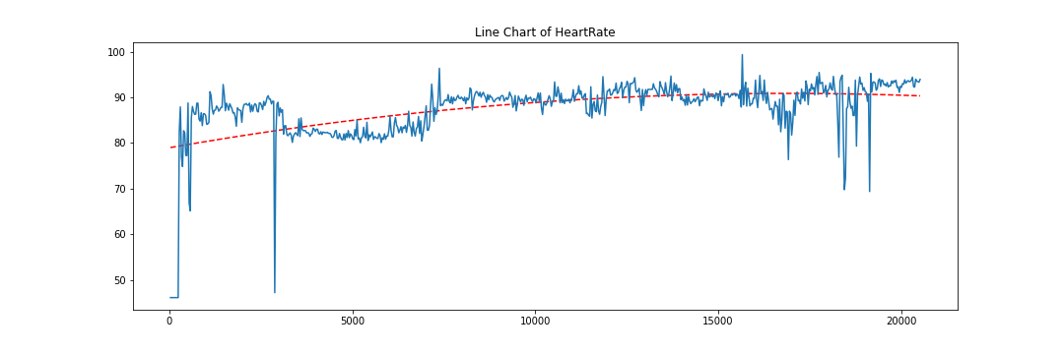
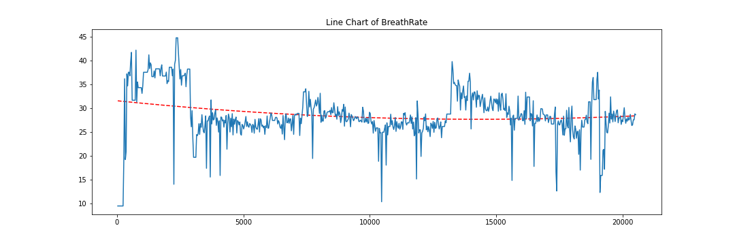
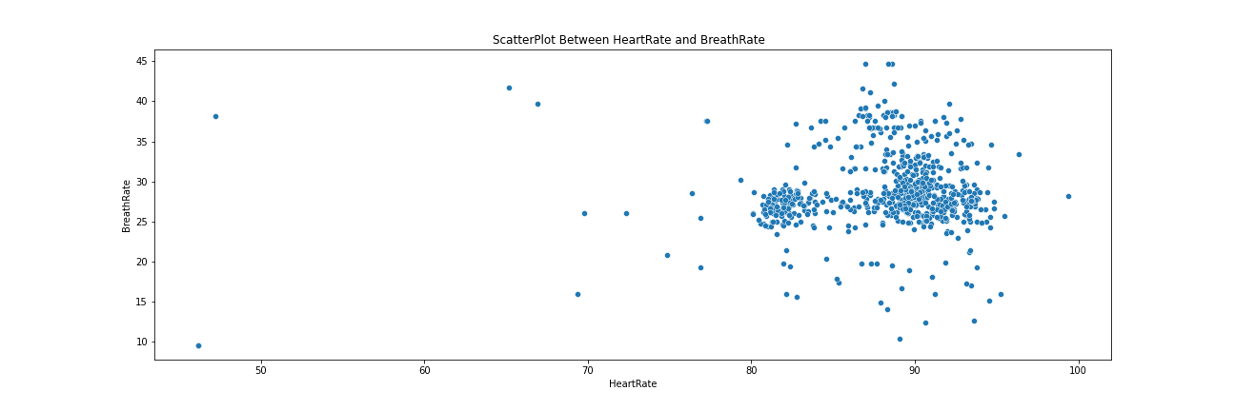
8th CSV

Slide 10
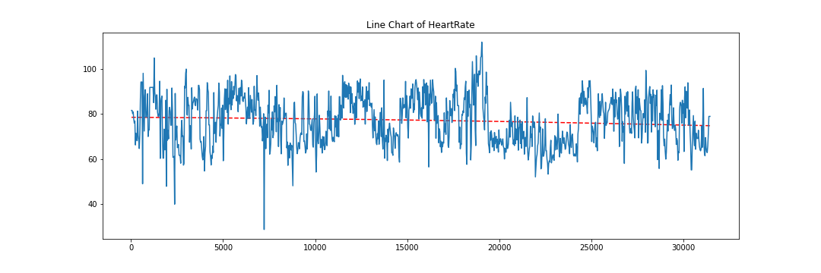
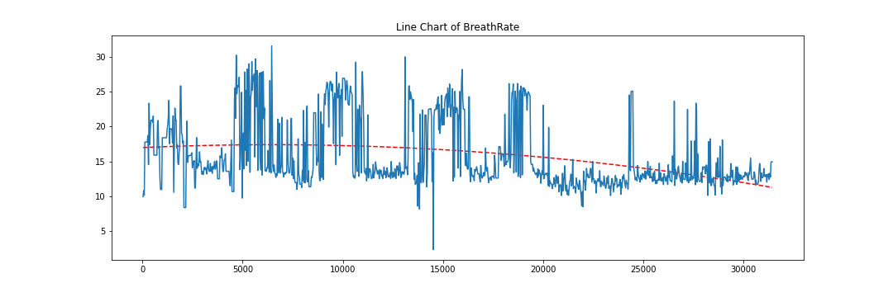
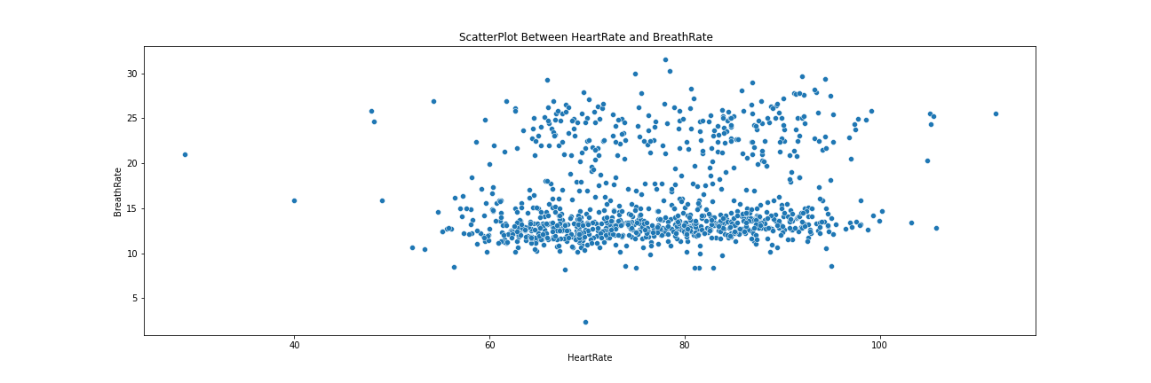
9th CSV

Slide 11
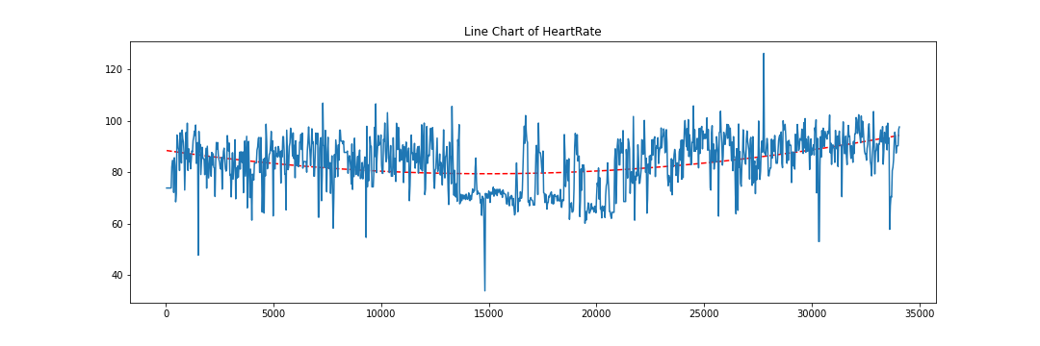
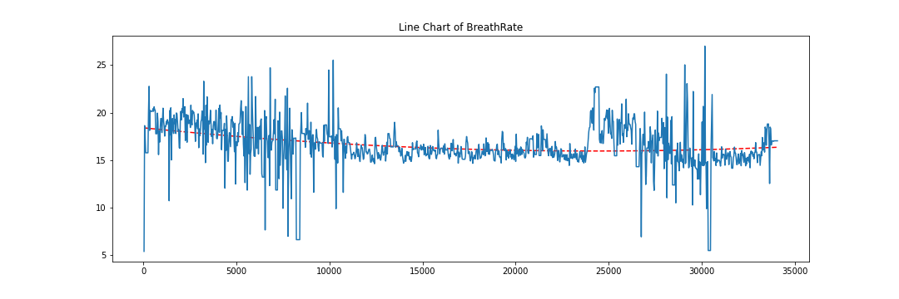
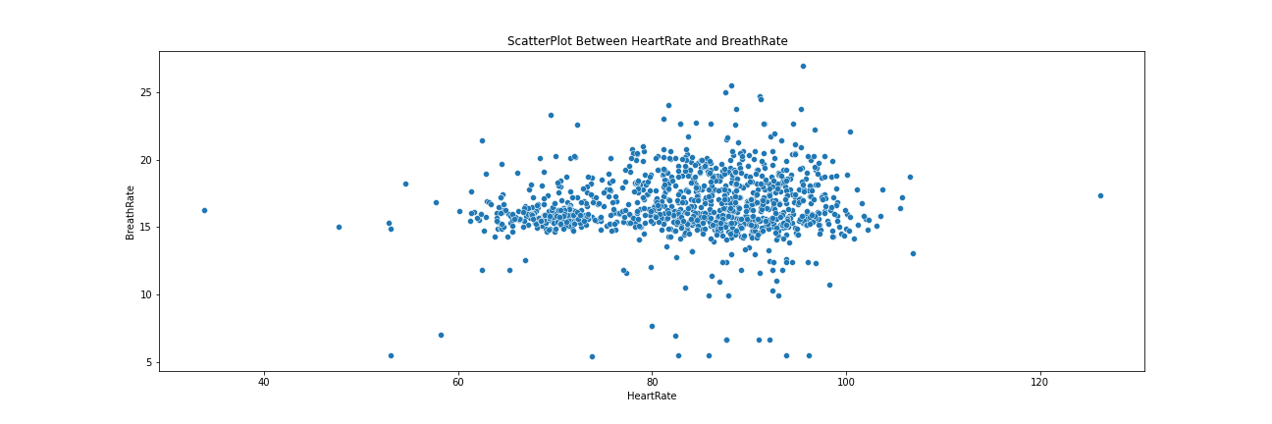
10th CSV

Slide 12
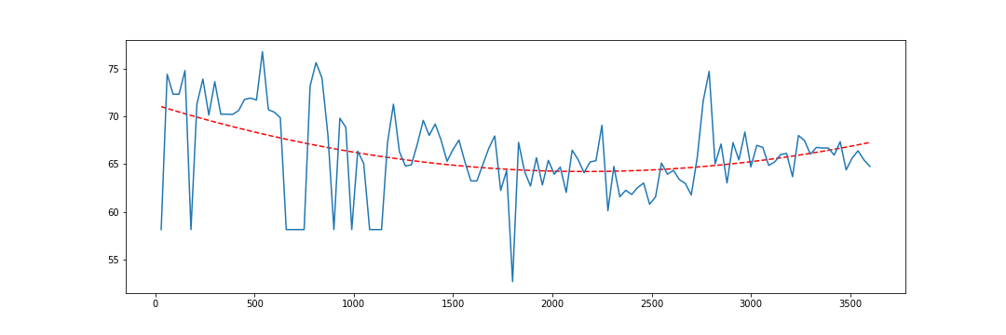
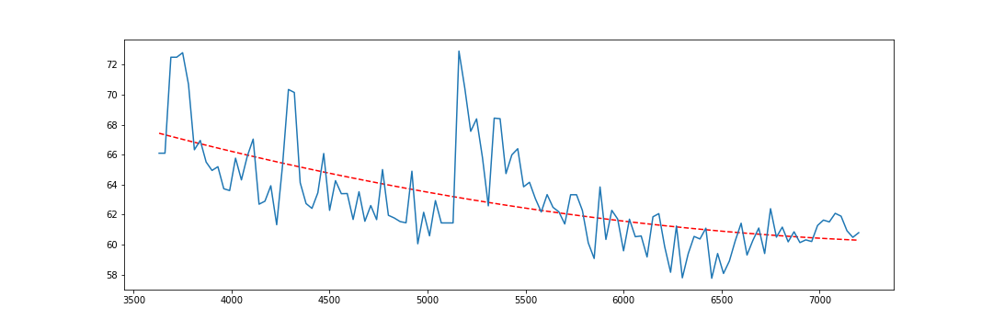
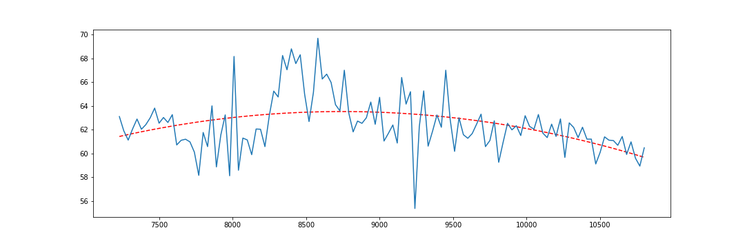
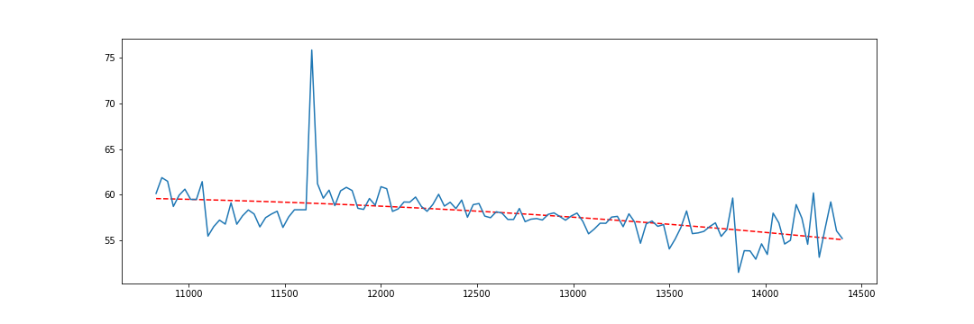
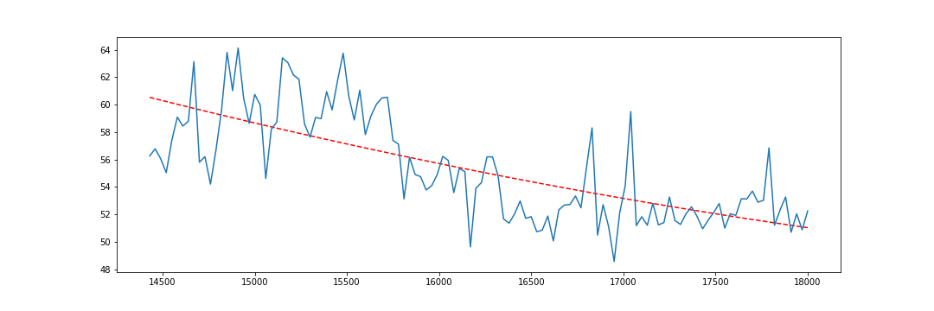
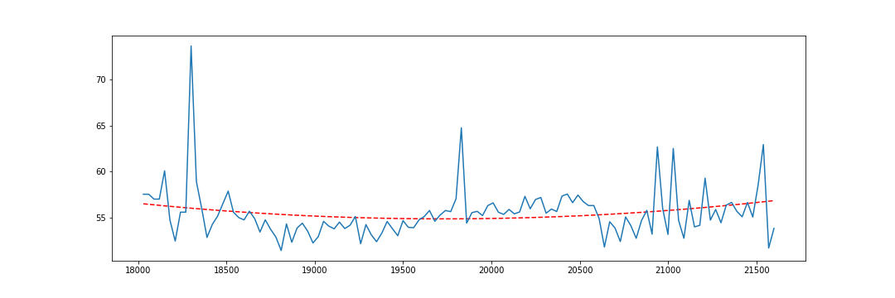
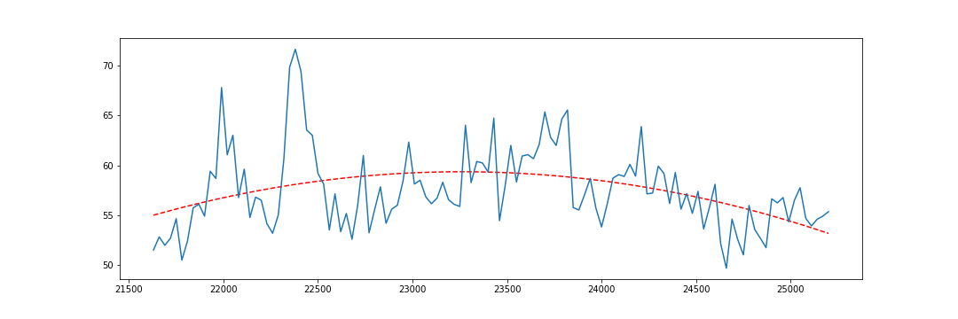
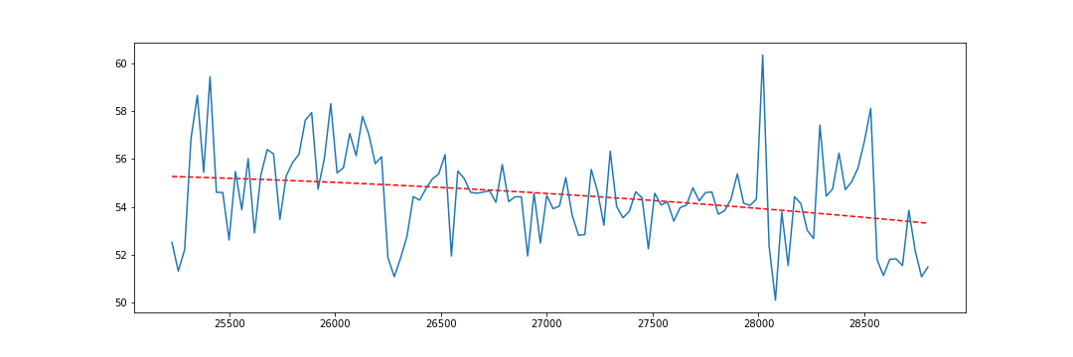
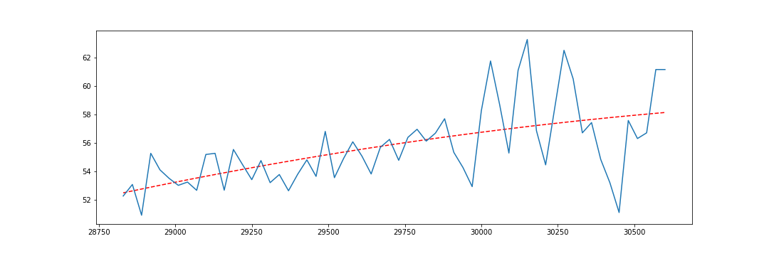
Heart Rate Windows Analysis for CSV1

Slide 14
Feature Engineering
Mean_HR | Mean of the HeartRate Values for each Window Individually.
Max_HR | Max HeartRate in the given Window.
Min_HR | Min HeartRate in the given Window.
25_HR | 25 percentile of HeartRate in the given Window.
50_HR | 50 percentile of HeartRate in the given Window.
75_HR | 75 percentile of HeartRate in the given Window.
Ske_HR | Calculating the skewness for HeartRate in the given Window.
Kurt_HR | Calculating the kurtosis for HeartRate in the given Window.
Mean_BR | Mean of the BreathRate Values for each Window Individually.
Max_BR | Max BreathRate in the given Window.
Min_BR | Min BreathRate in the given Window.
25_BR | 25 percentile of BreathRate in the given Window.
50_BR | 50 percentile of BreathRate in the given Window.
75_BR | 75 percentile of BreathRate in the given Window.
Skew_BR | Calculating the skewness for BreathRate in the given Window.
Kurt_BR | Calculating the kurtosis for BreathRate in the given Window.

Slide 15
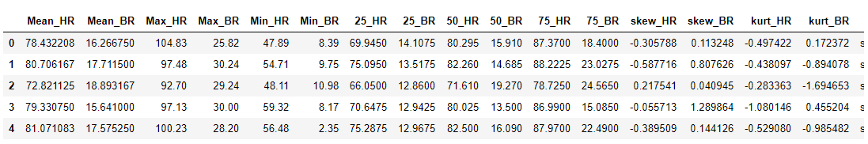
Final Data
Total Number of Rows : 80
Total Number of Columns : 16

Slide 16
Cluster Analysis
Using K means Clustering , divided the whole data set into 4 clusters.
Cluster 0
Cluster 1
Cluster 2
Cluster 3

Slide 17
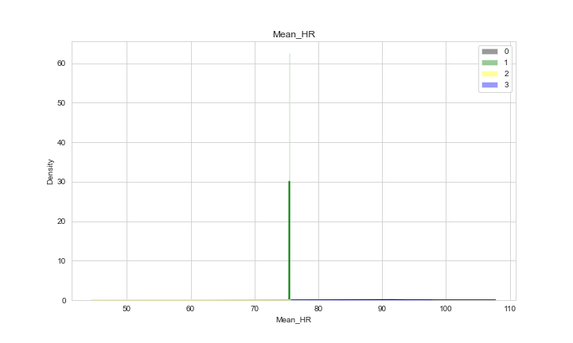
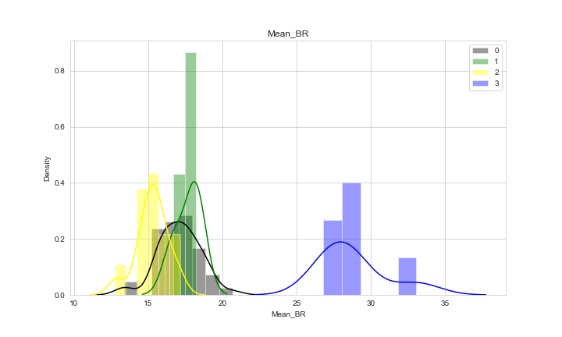
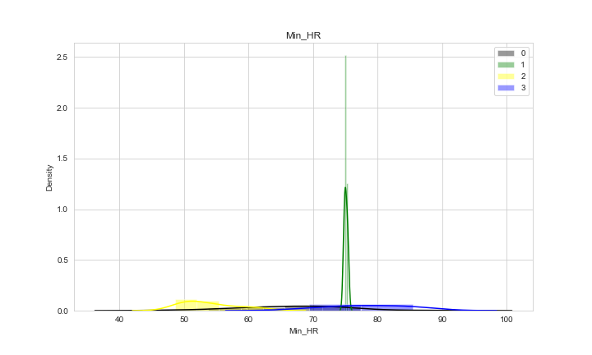
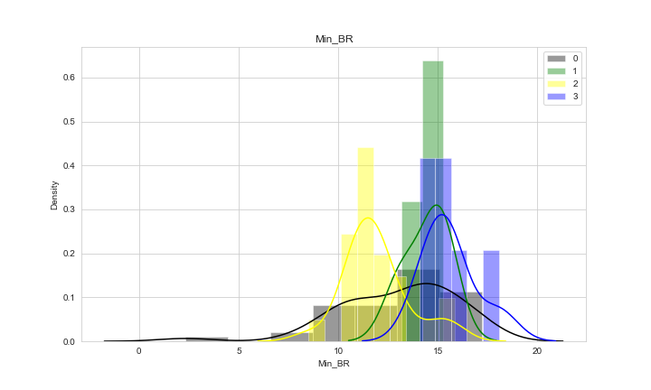

Slide 18
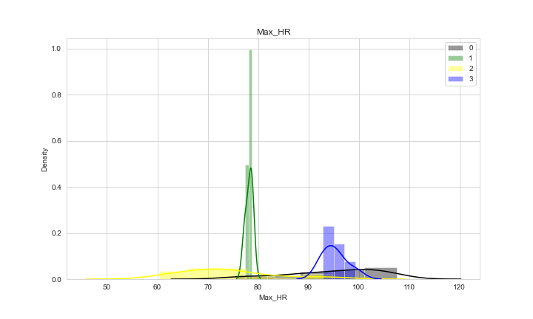
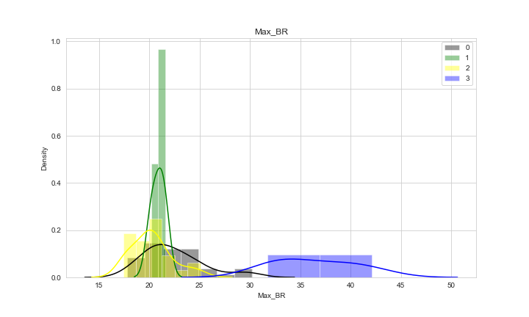
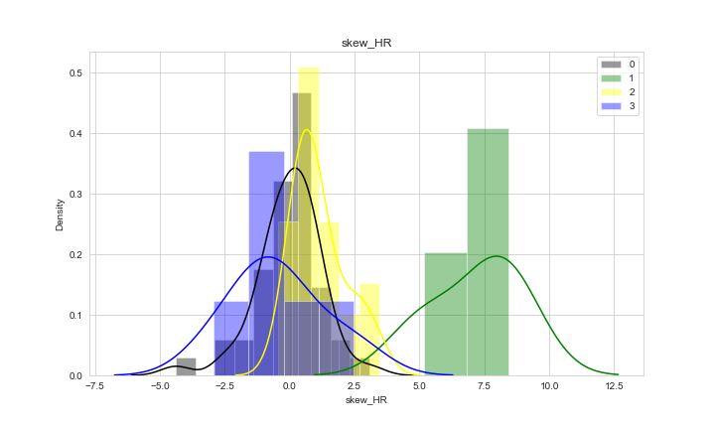
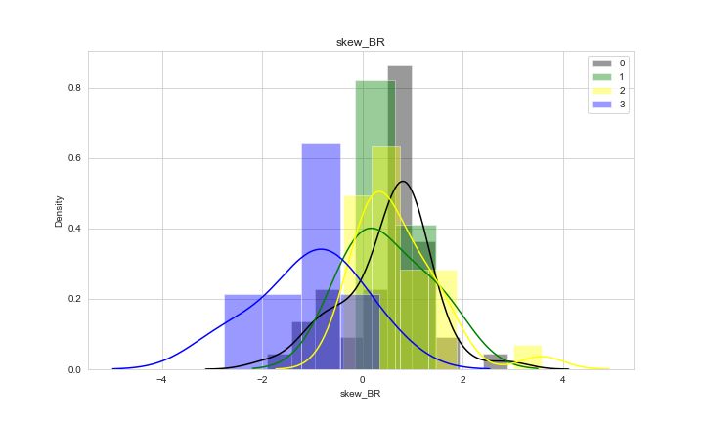

Slide 19
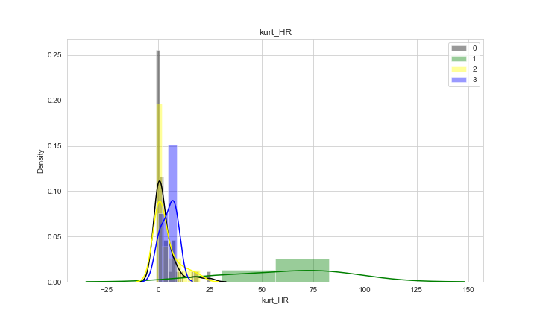
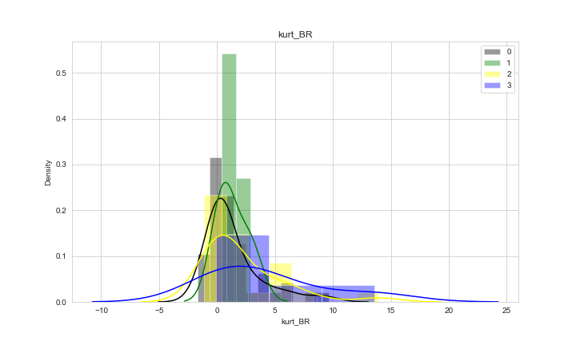



Slide 20





Slide 21
Cluster 0 Analysis
mean_HR 81.55525810934785
mean_BR 17.08722409173913
mean_std_HR 6.3500787187975485
mean_std_BR 1.4291426912080702
mean_skew_HR -0.02562587954347827
mean_skew_BR 0.5005588868260871
mean_kurt_HR 2.989339843652173
mean_kurt_BR 1.3552699171304352

Slide 22
Cluster 1 Analysis
mean_HR 75.45036111
mean_BR 17.69036111
mean_std_HR 0.011476222213612951
mean_std_BR 0.8642859322094656
mean_skew_HR 7.173984663333333
mean_skew_BR 0.5238021313333333
mean_kurt_HR 61.220615656666666
mean_kurt_BR 1.3321998659999998

Slide 23
Cluster 2 Analysis
mean_HR 61.319804696
mean_BR 15.2809087876
mean_std_HR 6.059114505052061
mean_std_BR 1.048315402987635
mean_skew_HR 1.1278454258400001
mean_skew_BR 0.7105730962800001
mean_kurt_HR 3.82209082208
mean_kurt_BR 2.1846677602799995

Slide 24
Cluster 3 Anaysis
mean_HR 88.35146329333334
mean_BR 28.769285715
mean_std_HR 3.24623238604122
mean_std_BR 2.236299299198899
mean_skew_HR -0.46258967633333326
mean_skew_BR -1.0726219508333334
mean_kurt_HR 5.1602329175
mean_kurt_BR 4.236597581333334

Slide 25
Final Ranking
Based on the HR Rate, BR Rate and the trend of the windows the 4 clusters are given Ranking(1-4)(1 being the Highest).
Cluster 2 : Rank1 : Healthy Sleep
Cluster 1 : Rank2 : Good Sleep
Cluster 0 : Rank3 : Bad Sleep
Cluster 3 : Rank4 : Worst Sleep

Slide 26
Thank You

